Slide 1
DATA SCIENCE TOOLS
Corey Maher

Slide 2
LET’S DISCUSS THE CURRENT LESSON OBEJCTIVES
Identify the data science toolkit we’ll be using in class
Learn how to navigate Git and the Command Line
Download the course Git repository and practice some git commands
Make a probability and odds IPython notebook (time permitting)
Slides will be available on the course repository for your reference.

Slide 3
INTRO
Name
Familiarity with programming, languages used
Familiarity with UNIX/command line tools
What you do for work/why you’re taking data science
Please post your github username in the slack channel so I can add you to our demo repository!

Slide 4
INTRODUCTION
TOOLS OF THE TRADE

Slide 5
TOOLS OF THE TRADE
Today we are going to review some of the tools we use in data science.
We’ll see how they fit into the wider programming environment.
We’ll start with the command line. This is your portal to your computer and the outside world.

Slide 6
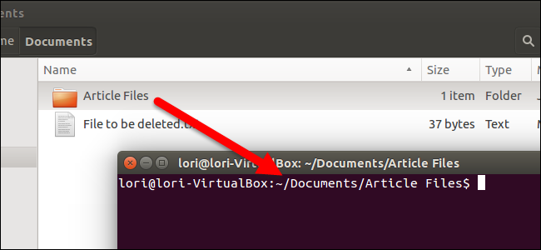
LOCAL MACHINE
On your local computer, you have a variety of tools at your disposal.
Text editor
Programs/tools
Your files
All of these can be accessed through the terminal or through a GUI (Graphical User Interface).
You can navigate your files through the terminal or through Finder.

Slide 7
DATA SCIENCE TOOLS
Terminal/ Command Line
Outside World
Local Machine

Slide 8
DEMO
COMMAND LINE

Slide 9
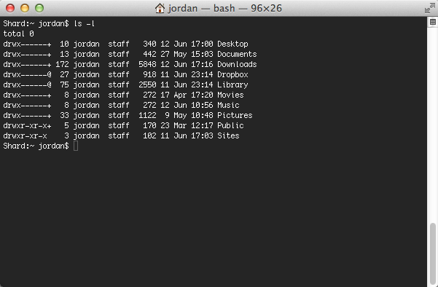
COMMAND LINE
Let’s walk through a few very basic commands.
cd
pwd
$home
mkdir
open
We can access many tools with the terminal. Let’s walk through a few.

Slide 10
DATA SCIENCE TOOLS
Terminal/ Command Line
Outside World
Local Machine
open, mkdir, cd, rm
Your Files

Slide 11
INTRODUCTION
TEXT EDITORS

Slide 12




TEXT EDITORS
So far, we’ve used iPython Notebooks in place of a text editor.
However, there are many options available
eMacs
Vim
Sublime Text
IDE (Integrated Development Environments) such as PyCharm or Eclipse
Many programmers love to argue at length about which is the ‘best’ one.
Let’s see what Sublime Text looks like with Python!

Slide 13
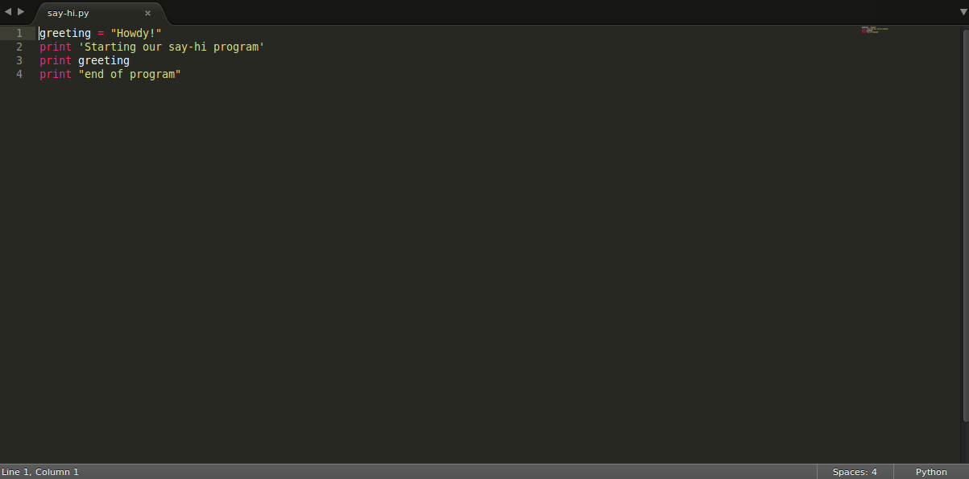
TEXT EDITORS

Slide 14
TEXT EDITORS
Open “say-hi.py”, found in the lesson-05 folder of the class repo, in Sublime Text to see it for yourself.
Check out the difference between saving a text file in MS Word and using sublime text

Slide 15
DATA SCIENCE TOOLS
Terminal/ Command Line
Outside World
Local Machine
open, mkdir, cd, rm
Your Files
Text Editor, e.g. Sublime Text
Edit

Slide 16

ACTIVITY: KNOWLEDGE CHECK
ANSWER THE FOLLOWING QUESTIONS
EXERCISE
Who has a text editor they like that I didn’t talk about? Why do you like it?
What are some good reasons to use a programming text editor instead of Microsoft Word or Google Docs?
DELIVERABLE
Answers to the above questions

Slide 17
INTRODUCTION
IPYTHON NOTEBOOK

Slide 18
IPYTHON NOTEBOOK
Where does iPython Notebook fit in?
We can refer to the iPython Notebook docs to get a better idea: the notebook combines the console, web apps, and markdown to capture the whole computation process.
IPython notebooks combine three components in sequential ‘cells’ that can be edited and run in any order:
Text (Markdown/HTML/Plain text)
Code
Output (plots, command line output, etc)

Slide 19
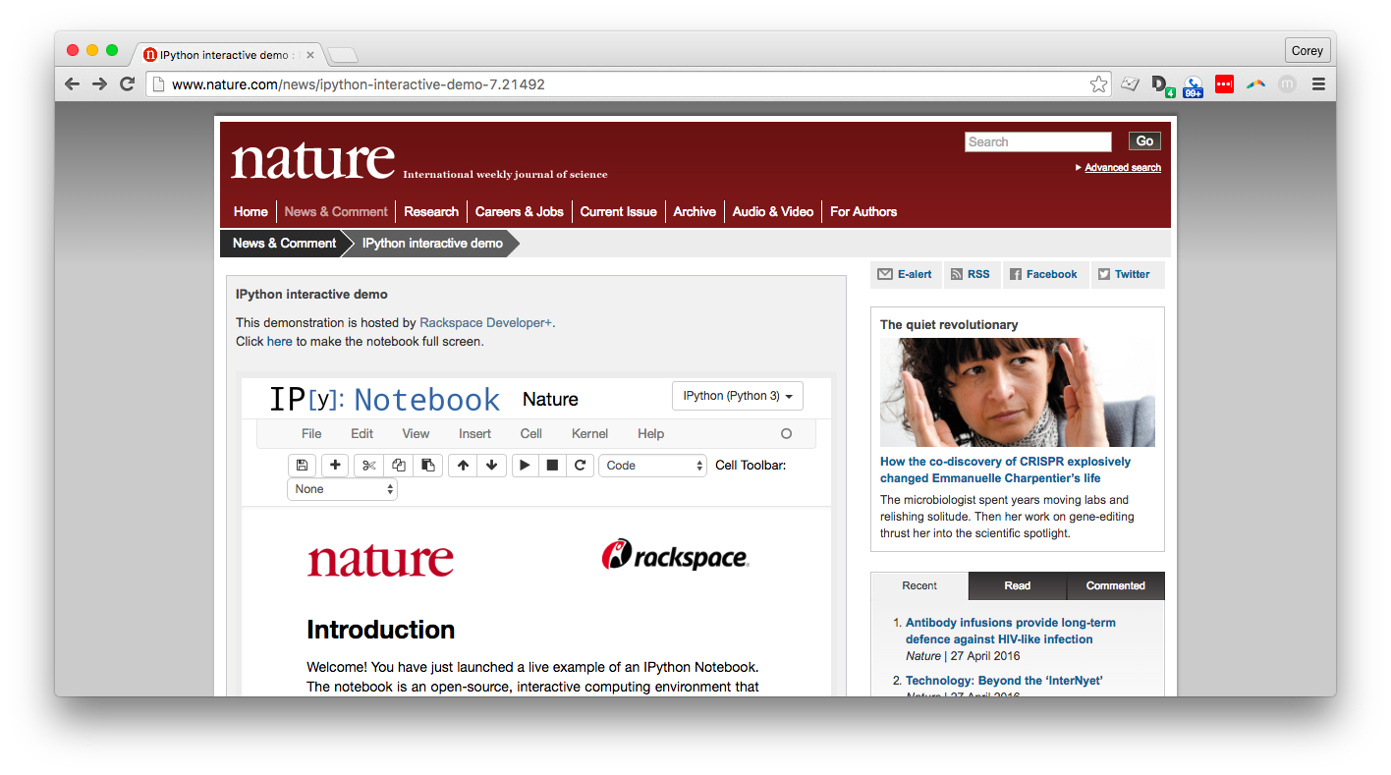
IPYTHON NOTEBOOK
IPython notebook demo:
https://nature.tmpnb.org

Slide 20
ACTIVITY: KNOWLEDGE CHECK
ANSWER THE FOLLOWING QUESTIONS
EXERCISE
What are the three components of IPython notebooks?
DELIVERABLE
Answers to the above questions

Slide 21
INTRODUCTION
PYTHON PACKAGES

Slide 22
PYTHON PACKAGES
The terminal allows us to run programs and reach out to the outside world.
We can add programs and packages as needed.
To add Python packages, we use a tool called pip.
Let’s pip install a package with the command line. We’ll install Beautiful Soup, a HTML/XML parsing package.
pip install beautifulsoup4

Slide 23
DATA SCIENCE TOOLS
Terminal/ Command Line
Outside World
Local Machine
open, mkdir, cd, rm
pip install
Your Files
Text Editor, e.g. Sublime Text
Python and Packages
Edit

Slide 24
INTRODUCTION
THE OUTSIDE WORLD

Slide 25
THE OUTSIDE WORLD
The command line also allows you to download and use other tools and packages.
There are many tools for different purposes available in the outside world.

Slide 26
DATA SCIENCE TOOLS
Tools and Packages
Terminal/ Command Line
Outside World
Local Machine
open, mkdir, cd, rm
pip install
Your Files
Text Editor, e.g. Sublime Text
Python and Packages
Edit

Slide 27
THE OUTSIDE WORLD
As we saw with pip, the command line can connect us to the outside world. This becomes more important for data.
We may have HIPAA protected data. This means we can’t leave this sensitive data on our local machine (i.e. laptop).
We need to communicate with a remote machine (i.e. server) to access the data via command line.
Let’s see a demonstration of this.

Slide 28
THE OUTSIDE WORLD
AWS EC2 demo
SSH
Local database
Text files
S3 Demo

Slide 29
DATA SCIENCE TOOLS
Tools and Packages
Remote Computers, e.g. AWS
SSH/tunnel
Terminal/ Command Line
Outside World
Local Machine
open, mkdir, cd, rm
pip install
Your Files
Text Editor, e.g. Sublime Text
Python and Packages
Edit

Slide 30
BREAK
10 mins

Slide 31
INTRODUCTION
GIT

Slide 32
GIT
Version control is necessary when working on complex projects.
Git is a way of tracking changes we’ve made to our programs that allows us to go back in time to fix errors.
Combined with Github, Git is a powerful tool for collaborating with colleagues. You can work on different aspects of projects simultaneously and merge the changes together seamlessly.
There are many different ways to use these tools.

Slide 33
GIT
Let’s see an example of using Git and Github.
There are three primary commands we’ll use.
git add
git commit
git push
When a colleague wants to implement our change, we may use the command git pull.

Slide 34
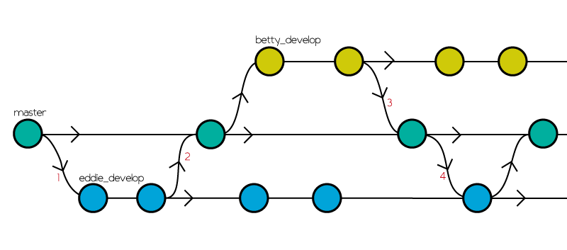
GIT

Slide 35
DATA SCIENCE TOOLS
Git and Github
Tools and Packages
Remote Computers, e.g. AWS
SSH/tunnel
git push
Terminal/ Command Line
git pull
Outside World
Local Machine
open, mkdir, cd, rm
pip install
Your Files
Text Editor, e.g. Sublime Text
Python and Packages
Edit

Slide 36
ACTIVITY: KNOWLEDGE CHECK
ANSWER THE FOLLOWING QUESTIONS
EXERCISE
How are Python software modules shared?
What tools do you use to find and get new Python software?
DELIVERABLE
Answers to the above questions

Slide 37
GUIDED PRACTICE
GIT AND COMMAND LINE

Slide 38
ACTIVITY: GIT AND COMMAND LINE
DIRECTIONS (30 minutes)
EXERCISE
https://guides.github.com/activities/hello-world/
https://try.github.io/
Don’t forget to paste your github username in the slack channel if you haven’t done so already
DELIVERABLE
Github username

Slide 39
LESSON
Q & A

Slide 40
BREAK
10 mins

Slide 41
BRINGING IT ALL TOGETHER
GIT EXERCISE

Slide 42
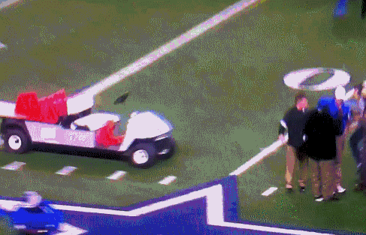
GIT
Goal: to fork and clone our own repositories on github, make sure we can edit a trivial file, and push it back up.
Secondary goal: become comfortable wrestling the Git monster.
When the office git expert has to come fix everything
source: http://wheningit.tumblr.com/post...

Slide 43
BRINGING IT ALL TOGETHER
Activity (20 mins)
EXERCISE
Break into groups of 4
Fork and clone the class repository at https://github.com/coreym/DAT-35-class-3
Create a text file in students/firstnamelastname.txt with your first name, last name, favorite food, and first place you would go if someone gave you a free plane ticket anywhere in the world.
‘Git add’ the text file to your local repository
‘Git commit -m “type a commit message here”’
‘Git push origin’
DELIVERABLE
A link to your text file on github in the slack channel

Slide 44
GUIDED PRACTICE
ODDS AND PROBABILITY

Slide 45
ACTIVITY: ODDS & PROBABILITY
DIRECTIONS (20 minutes)
EXERCISE
Some of you may already be familiar with odds and probability.
We will use the starter code in lesson-05 of the class repo to review the concepts of odds and probability.
DELIVERABLE
Answer the questions in the notebook

Slide 46
CONCLUSION
TOPIC REVIEW

Slide 47
REVIEW
What are some common data science tools?
Why are these tools useful?
Any other questions?

Slide 48
COURSE
BEFORE NEXT CLASS:
Come to office hours Saturday with me 10-12 if we need to keep working on your laptop setup.

Slide 49
LESSON
EXIT TICKET
DON’T FORGET TO FILL OUT YOUR EXIT TICKET
http://goo.gl/forms/ICFjthGo5V

